Slide 1



Bank CRM Analysis
Project Report by –Sahazadi Khatun

Slide 2

Contents
Introduction
Problem Statement
Data Overview (Schema)
Metrics and their Insights
Dashboard Snippets
Challenges Faced
Conclusion
Recommendations

Slide 3
Introduction
In today’s competitive banking environment, understanding customer behavior is crucial to reducing churn and improving satisfaction. This project focuses on analyzing customer data to uncover actionable insights that help the bank strengthen relationships, enhance service delivery, and retain valuable clients.
Using SQL for data extraction, cleaning, and transformation, and Power BI for visualization and reporting, this analysis integrates multiple datasets — including customer demographics, transaction details, exit information, and active customer profiles.
The objective is to build a data-driven understanding of customer patterns, identify key factors influencing churn, and provide strategic recommendations that enable the bank to make informed, customer-centric decisions.
Tools Used – Power BI Desktop, MySQL Workbench, MS-Office

Slide 4
Problem Statement
You are an analytical CRM (Customer Relationship Management) specialist hired by a bank to extract meaningful insights from various customer-related datasets. The bank aims to reduce customer churn, improve service delivery, and enhance customer satisfaction. They have provided you with datasets including customer demographics, transaction details, customer exit information, and active customer profiles.

Slide 5
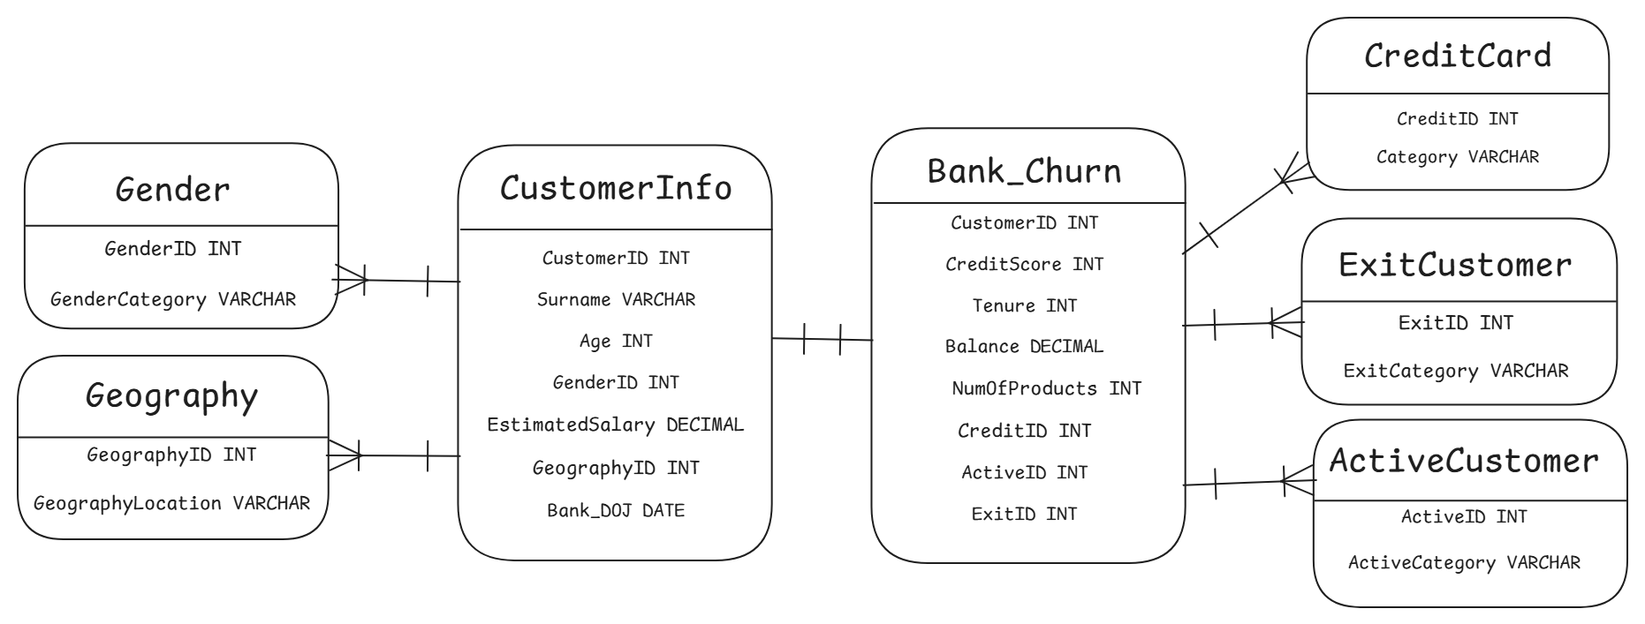
Data Schema

Slide 6
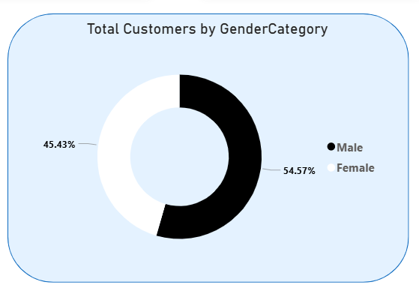
Number of Customers by Gender
The customer base is slightly male-dominant.
Males account for 54.57% of total customers.
Females represent 45.43% of total customers.
The gender distribution is fairly balanced, with less than a 10% difference.
This indicates broad appeal across genders, with a small edge toward male customers.

Slide 7
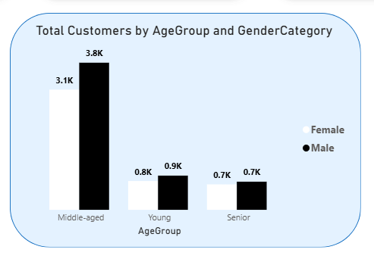
Number of Customers by AgeGroup and Gender
Middle-aged customers form the largest segment for both genders.
Males (3.8K) outnumber females (3.1K) in the middle-aged group.
Young and senior age groups have similar and smaller customer counts.
Gender distribution is balanced in young and senior groups.
The data suggests the business appeals most strongly to middle-aged males.

Slide 8
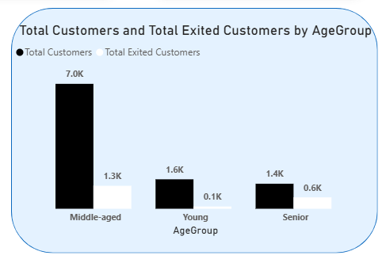
Number of Customers and Exited Customers by AgeGroup
Middle-aged customers make up the largest group (7.0K) overall.
They also have the highest number of exits (1.3K) among all age groups.
Young customers have the lowest exit rate (0.1K out of 1.6K).
Senior customers show a moderate exit rate (0.6K out of 1.4K).
Overall, customer retention is strongest among younger customers and weakest among middle-aged customers.

Slide 9
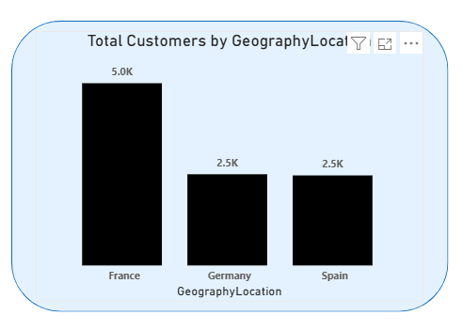
Number of Customers by
Geography Locations
France has the highest number of customers (5K).
Germany and Spain have equal customer counts (2.5K each).
France holds 50% of total customers, while Germany and Spain each contribute 25%.
The customer base is heavily concentrated in France, suggesting potential growth opportunities in Germany and Spain.

Slide 10
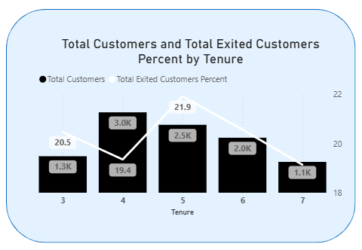
Number of Customers and Exited Customers by AgeGroup
Tenure 4 has the highest number of customers (3K).
Exit rate peaks at tenure 5 (21.9%), indicating higher churn risk around this stage.
Lowest exit rate at tenure 4 (19.4%), despite having the most customers.
Customer count declines after tenure 5, suggesting retention challenges with longer tenure.
Focus retention efforts on customers with 5+ years tenure to reduce churn.

Slide 11
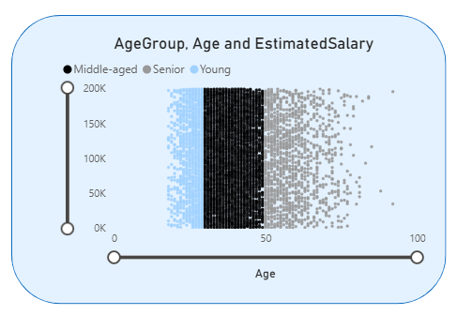
Age vs. Estimated Salary by AgeGroup
Middle-aged group forms the largest segment of customers.
Young customers mostly have lower estimated salaries (<100K).
Seniors show a wider salary range, including the highest earners.
Salary variation increases with age, indicating greater income diversity among older customers.
Potential to target middle-aged and senior segments for higher-value offerings.

Slide 12
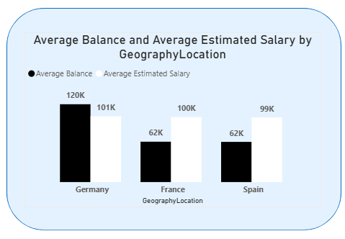
Average Balance and Estimated Salary by Geography Location
Germany shows the highest average balance (120K) among all countries.
France and Spain have the same average balance (62K), much lower than Germany.
Despite the lower balance, France and Spain have similar estimated salaries (~100K).
Germany’s higher balance suggests stronger savings or financial stability.
Overall, salaries are consistent, but balances vary significantly by geography.

Slide 13
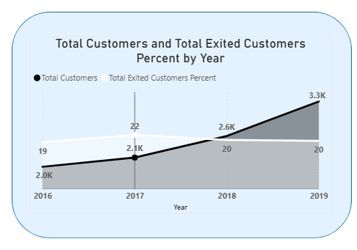
Total Customers and Exited Customers Percent Yearly
Total customers grew steadily from 2.0K (2016) to 3.3K (2019).
Exited customer percentage stayed relatively stable between 19–22%.
Despite strong customer growth, the exit rate didn’t improve over the years.
Indicates customer acquisition is rising, but retention challenges persist.

Slide 14
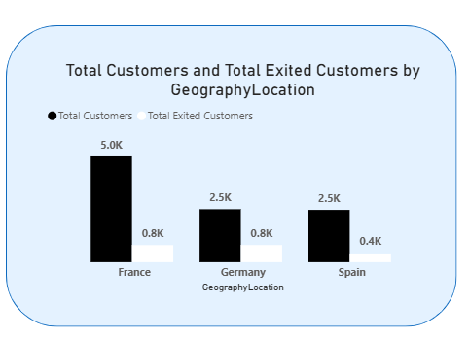
Total Customers and Exited Customers by Geography Location
France has the highest customer base (5.0K) among all countries.
Germany and Spain have equal total customers (2.5K each).
Exited customers are highest in France and Germany (0.8K each).
Spain has the lowest exits (0.4K), indicating better customer retention.
Overall, France leads in customers but also faces higher churn.

Slide 15
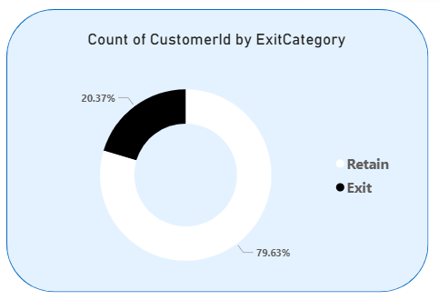
Percentage of Customers
Exited Category
79.63% of customers are retained, showing strong overall loyalty.
20.37% of customers have exited, indicating moderate churn.
The retention rate is healthy, but reducing churn could further boost growth.
Focus on understanding exit reasons to improve long-term customer retention.

Slide 16
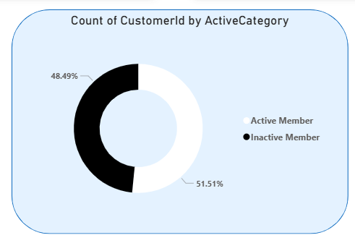
Percentage of Customers
Active Category
51.51% of customers are active members, slightly higher than inactive ones.
48.49% are inactive, indicating near-equal engagement levels.
The small gap suggests a need to boost customer activity and involvement.
Engagement programs could help convert inactive members to active ones.

Slide 17
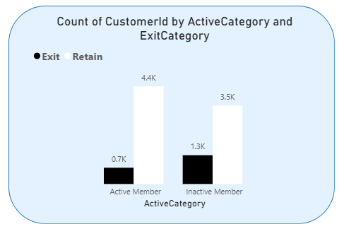
Total Customers by Exited
and Active Category
Active members: 4.4K retained, only 0.7K exited — strong loyalty.
Inactive members: Higher exits (1.3K) compared to active ones.
Retention is significantly better among active customers.
Indicates that customer engagement directly reduces churn.

Slide 18
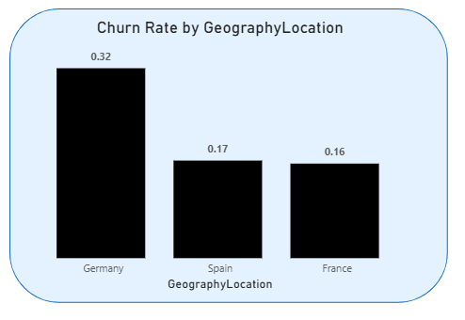
Churn Rate by Geography Location
Germany shows the highest churn rate (0.32) — key area of concern.
Spain (0.17) and France (0.16) have much lower churn rates.
Indicates customer retention issues are most severe in Germany.
Focused retention strategies are needed for the German market.

Slide 19
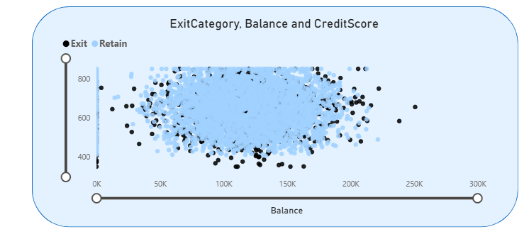
Balance vs. Credit Score
by Exited Category
Most customers (retained and exited) have balances between 50K–200K.
Exited customers (black dots) are scattered across all balance levels.
Credit scores show no strong separation between exited and retained customers.
Indicates that balance and credit score alone don’t strongly predict churn.
Suggests other factors (e.g., engagement, geography) may influence exits.

Slide 20
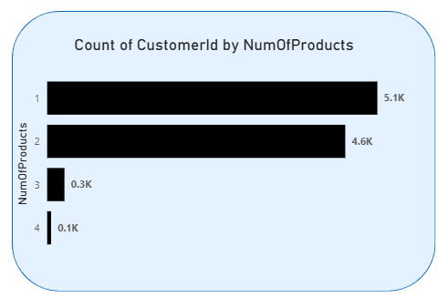
Number Of Customer by NumOfProducts
Majority of customers hold 1 or 2 products (5.1K and 4.6K respectively).
Very few customers have 3 or more products (only 0.4K combined).
Indicates limited cross-selling of additional products.
Opportunity to increase revenue by promoting multi-product adoption.

Slide 21
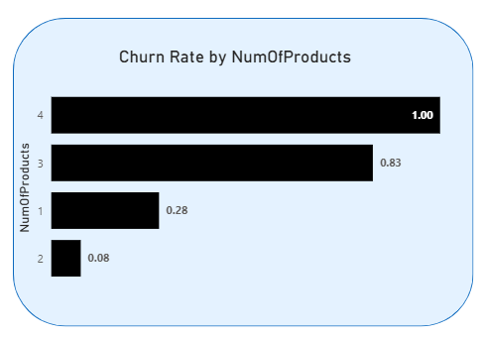
Churn Rate
by NoOfProducts
Churn rate rises sharply with the number of products.
Customers with 4 products have 100% churn, the highest risk group.
3-product customers also show a very high churn (0.83).
2-product customers have the lowest churn (0.08) — most stable segment.
Indicates a potential issue with multi-product customers — needs investigation.

Slide 22
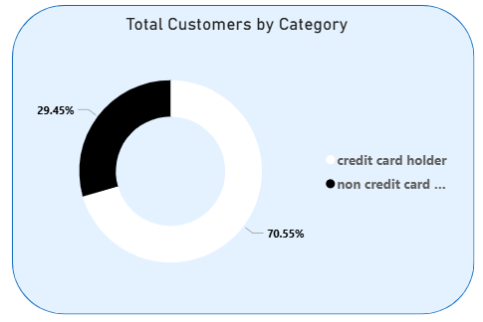
Number Of Customer by
Credit Card Category
70.55% of customers are credit card holders.
29.45% are non–credit card holders.
Majority of the customer base prefers credit card usage.
Indicates strong adoption of credit products among customers.

Slide 23
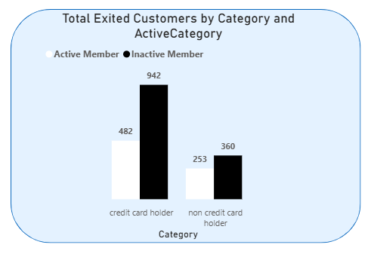
Number Of Exited Customer by
Credit Card Category and Active Category
Inactive credit card holders have the highest exits (942).
Active credit card holders exited less (482).
Among non–credit card holders, exits are lower overall (360 inactive, 253 active).
Indicates inactivity drives churn, especially among credit card users.

Slide 24
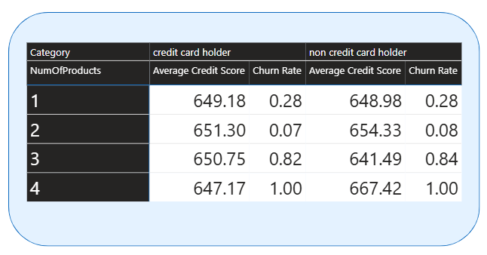
Churn Rate & Credit Score by Product Count and Card Type
Credit scores are similar across both categories (credit & non-credit holders).
Churn rate pattern is identical for both groups — rises with more products.
Lowest churn for customers with 2 products (≈0.07–0.08).
Highest churn (1.00) seen in 4-product customers, regardless of credit card status.
Suggests number of products is a stronger churn driver than credit card usage or credit score.

Slide 25
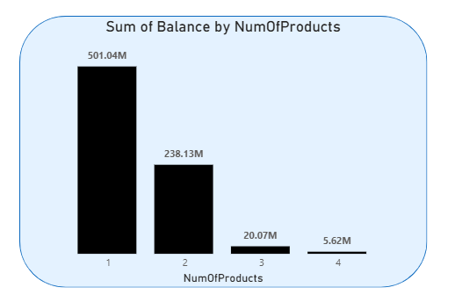
Total Balance Distribution by Number of Products
Customers with 1 product hold the highest total balance (501.04M).
Balances drop sharply as the number of products increases.
3- and 4-product customers contribute minimal balances.
Indicates that high-value customers prefer fewer products.
Suggests need to analyze multi-product strategy for profitability.

Slide 26
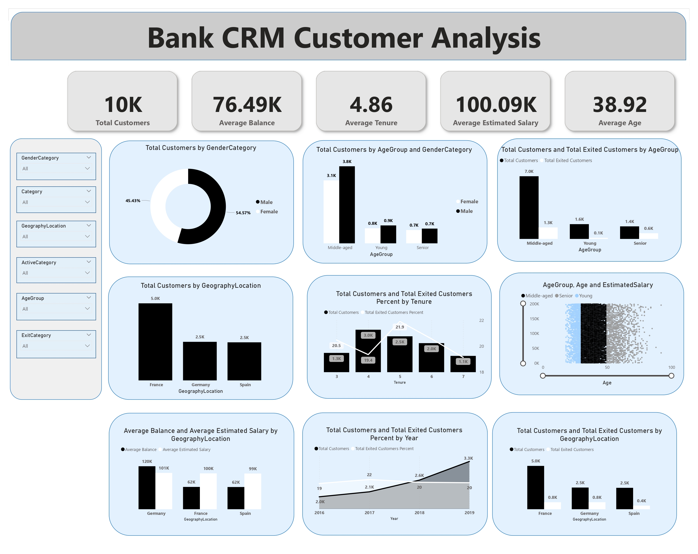

Slide 27
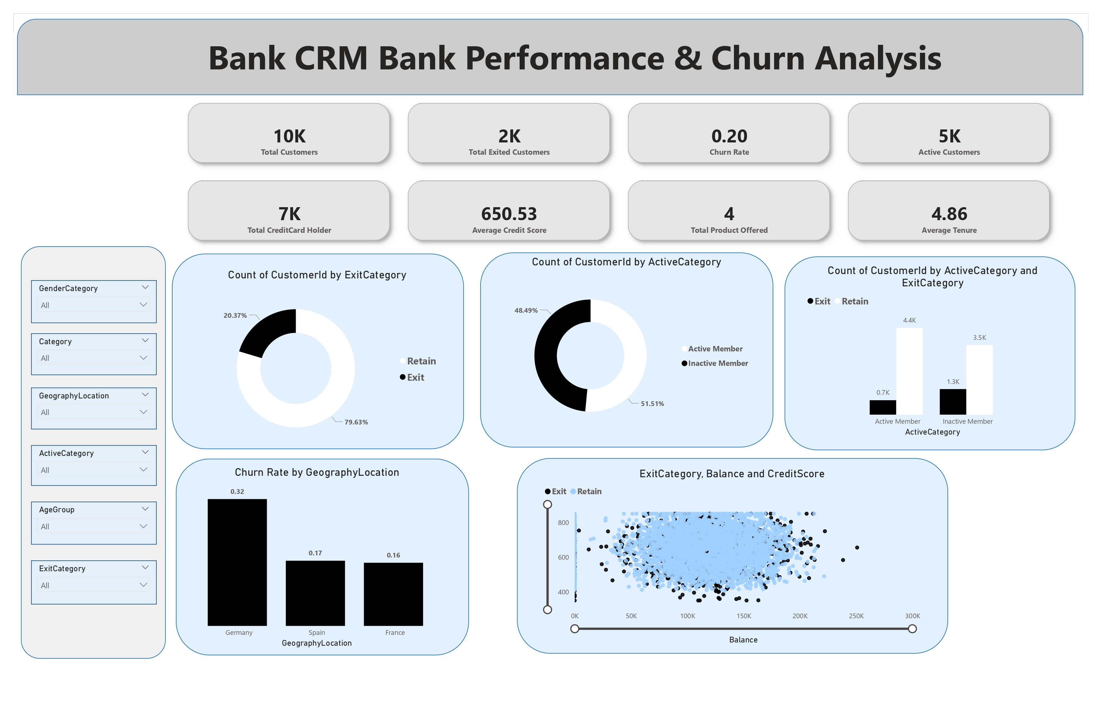

Slide 28
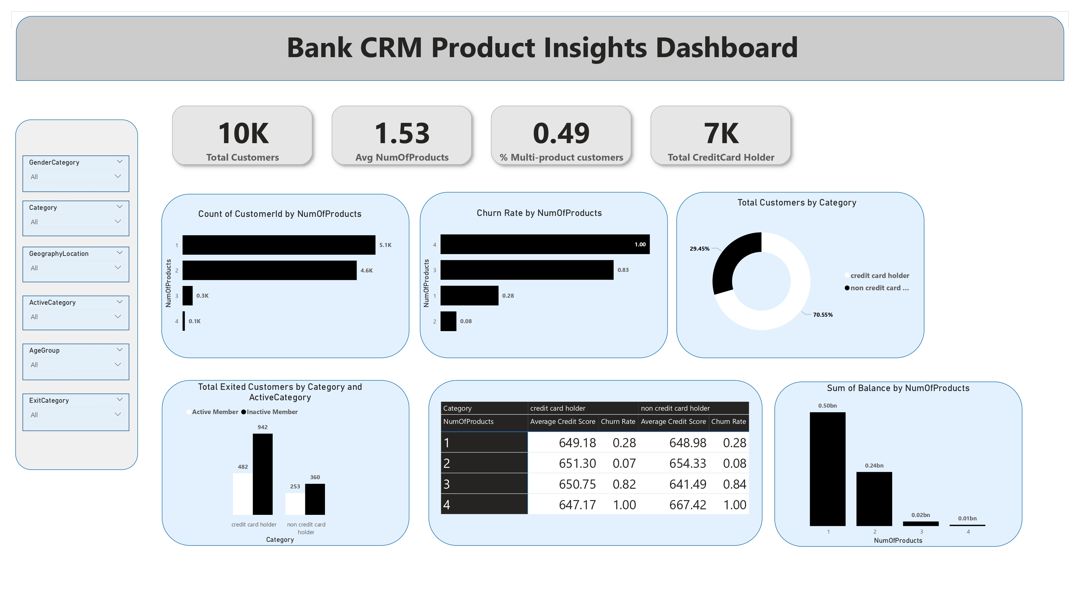

Slide 29
Challenges
Limited Data Availability: Access to comprehensive datasets was limited, as several key variables were missing, reducing the depth and scope of analysis.
Technical Restrictions: The available tools and technologies imposed constraints on performing advanced analytics and implementing complex machine learning models.
Complexity of Analysis: Analyzing customer behavior and predicting churn required identifying intricate relationships within the data, demanding advanced analytical methods and careful interpretation.
Overcoming Obstacles: These challenges were addressed through iterative problem-solving, effective resource utilization, and fostering adaptability to manage uncertainty and data limitations.

Slide 30
Conclusion
High-Risk Segments: Churn is highest among females aged 50+ (52.4%) and German customers (32.4%), indicating the need for targeted retention strategies.
Loyal Segments: Young customers (18–30) and those with mid credit scores (670–739) show the lowest churn, reflecting strong loyalty.
Market Insights: France demonstrates the strongest market presence with high customer volume and a low exit rate (16.2%).
Product Engagement: Most customers hold only one product but maintain the highest balances, presenting a strong upselling opportunity.
Cross-Sell Potential: Non–credit card holders (29.45%) represent a valuable target group for cross-selling.
Behavioral Insight: Salary shows no correlation with credit score or balance, making it an ineffective churn predictor.

Slide 31
Recommendations
Target High-Churn Segments: Focus retention efforts on females aged 50+ and German customers, as they exhibit the highest churn rates.
Enhance Product Engagement: Launch personalized upselling and cross-selling campaigns for single-product holders and non–credit card users to boost engagement and revenue.
Strengthen Customer Loyalty: Expand loyalty programs for the 30–50 male segment, leveraging their size and moderate stability to build long-term retention.
Promote Positive Credit Behavior: Encourage and reward behaviors seen in the mid-credit score group (670–739) to sustain their low churn levels.
Refine Targeting Approach: Avoid salary-based segmentation, as salary shows minimal influence on churn, balance, or credit score.
Geographic Focus: Prioritize France and Spain for business expansion, given their strong customer loyalty and manageable churn rates.

Slide 32
Thank you!

